Slide 1
Cherry Belle
By : Felicia

Slide 3
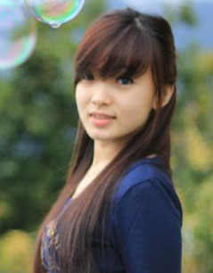
Angel

Slide 4
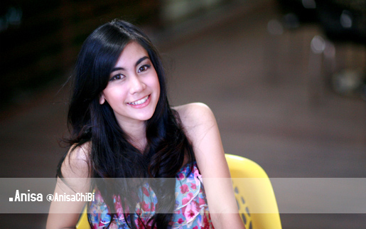
Anisa

Slide 5
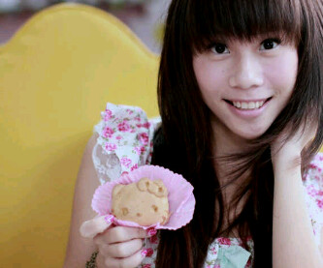
Cherly

Slide 6

Christy

Slide 7
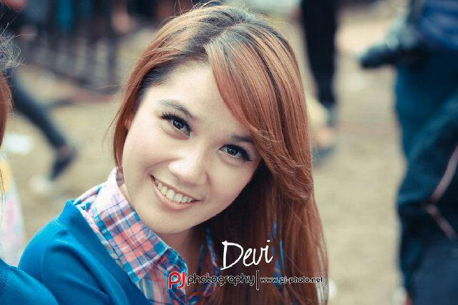
Devi

Slide 8
Gigi

Slide 9
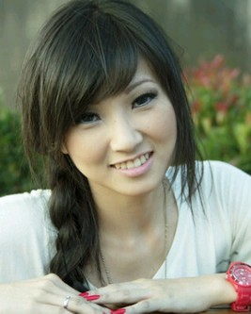
Wenda

Slide 10
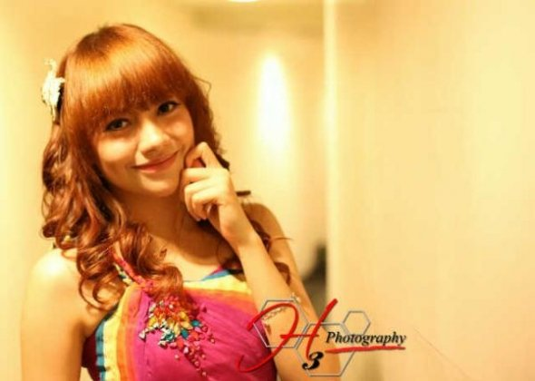
Kezia

Slide 11
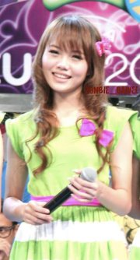
Stefani

Slide 12
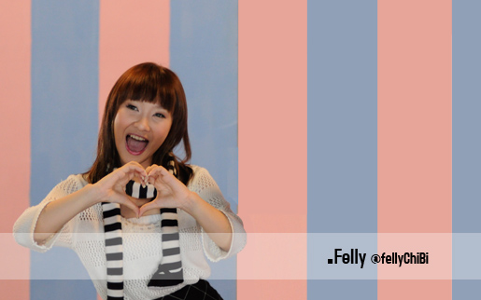
Felly

Slide 13

Ryn

